Slide 1
MQTT Security
Frank Walsh

Slide 2
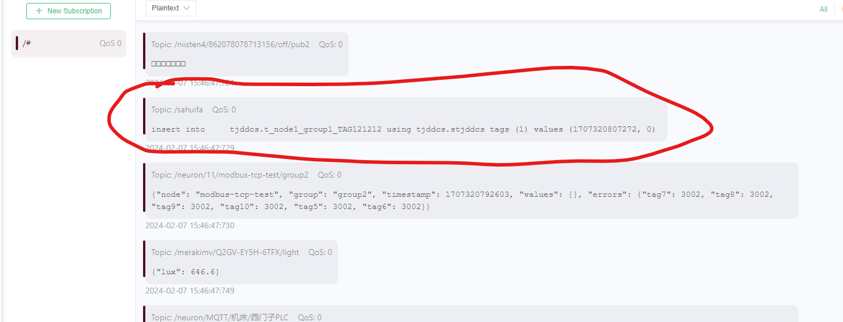
Not good…..

Slide 3

Security in IoT
Internet of Things presents new security implementation challenges
IoT devices have limited computing power and memory capacity
Cryptographic algorithms may require more resources than constrained IoT devices possess
Critical security issues may require updates to be rolled out to all devices simultaneously can be affected by unreliable networks on which many IoT devices
Security is a critical concern for developers of IoT applications.

Slide 4
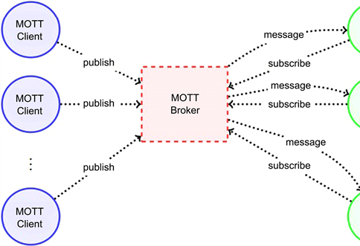
Security in MQTT
We can take a “layered” approach over the protocol stack
MQTT specifies only a few security mechanisms
MQTT uses other accepted security standards at the various levels:
E.g.SSL/TLS for transport security.
Network Layer: Use a VPN for all communication between clients and brokers. Gateway-based applications, the gateway is connected to devices on the one hand and with the broker over VPN on the other side.
Transport Layer: TLS/SSL
Application Layer: Authorisation using username/password provided by the Protocol
This Photo by Unknown Author is licensed under CC BY

Slide 5
MQTT Authentication
The MQTT protocol provides username and password fields in the CONNECT message for authentication
Username is an UTF-8 encoded string.
Password is binary data with a maximum of 65535 bytes.
The MQTT broker evaluates credentials and returns one of the following return codes:
0 – Connection Accepted
4 – Connection Refused, bad username/password
5 – Connection Refused, not authorised
Username/password sent as plain text - Secure transmission of usernames and passwords requires transport encryption

Slide 6

Transport Layer Security (TLS)
TLS provide a secure communication channel between a client and a server at Transport Layer.
TLS is a cryptographic protocol which use a handshake mechanism to negotiate various parameters to create a secure connection between the client and the server.
Servers provide a certificate (typically issued by a trusted authority) that clients use to verify the identity of the server.
While the additional CPU usage is typically negligible on the broker, small constrained devices are not designed for computation-intensive tasks.
If TLS is not possible, payload encryption and at least hash or encrypt the password in the CONNECT message of your client.

Slide 7
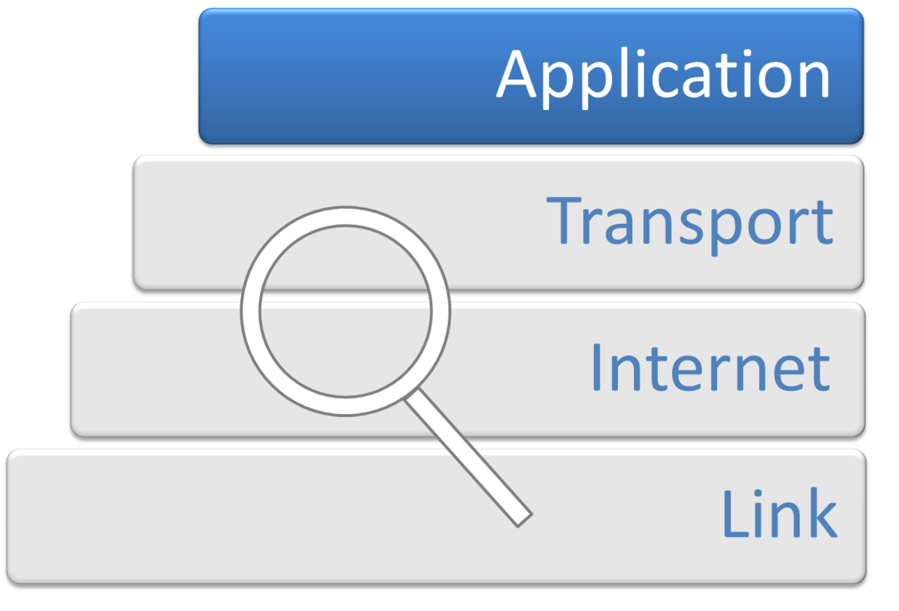
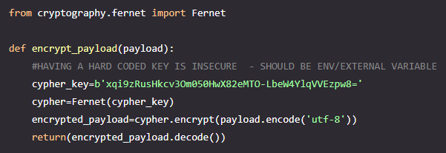
Application Level Encryption
End to End encryption between publisher and subscriber
Encrypt the payload without having to configure the MQTT broker
Means publisher and subscriber applications have to “know” encryption/decryption method. Has to be coded
Possible alternative for constrained devices that cannot support TLS
Possible (less secure) alternative for using public brokers.
This Photo by Unknown Author is licensed under CC BY-SA

Slide 8
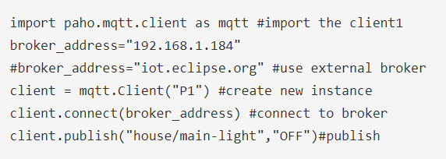
Raspberry Pi: Creating MQTT Clients in Python: Publishing Client
We’ll use Paho MQTT python client from Eclipse
Import the client class to provide functions to publish messages and subscribe to topics on MQTT brokers.
Create instance and connect to a broker:

Slide 9
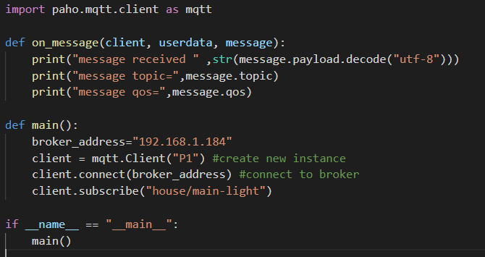
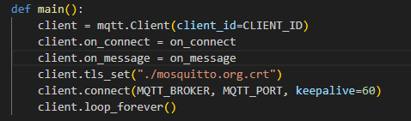
Raspberry Pi: Creating MQTT Clients in Python: Subscribing Client Callback
When the client receives messages it generate the on_message callback.

Slide 10
Arduino: Creating MQTT Clients in a Sketch: Publishing Client
Uses PubSubCLient from Arduino Library
#include <PubSubClient.h>
WiFiClient wifiClient;
PubSubClient client(wifiClient);
client.setServer(mqttServer, mqttPort);
client.connect(connectionId)
client.publish("/fxwalsh/temperature", message);
Construct MQTT client using wifiClient
Set MQTT Server and port
Create Connection
Publish message to topic!

Slide 11
Javascript/Node.js MQTT Client
const mqtt = require('mqtt');
const client = mqtt.connect('mqtt://broker.emqx.io');
const topic = '/fxwalsh/temperature';
client.on('connect', function () {
client.subscribe(topic, function (err) {
if (!err) {
console.log(`Subscribed to ${topic}`);
}
});
});
client.on('message', function (topic, message) {
// message is a buffer
console.log(message.toString());
});

